Slide 1
AND HOW TO READ THEM

Slide 2
READ
To look at carefully to understand the meaning of
To interpret the meaning of
To make out the significance of by observation or scrutiny
We learn to read WORDS from the time we are little
What else, though, do we have experience reading?
Notes:
Onomatopoeia to portray sound effects related to mood, conflict, character reactions

Slide 3
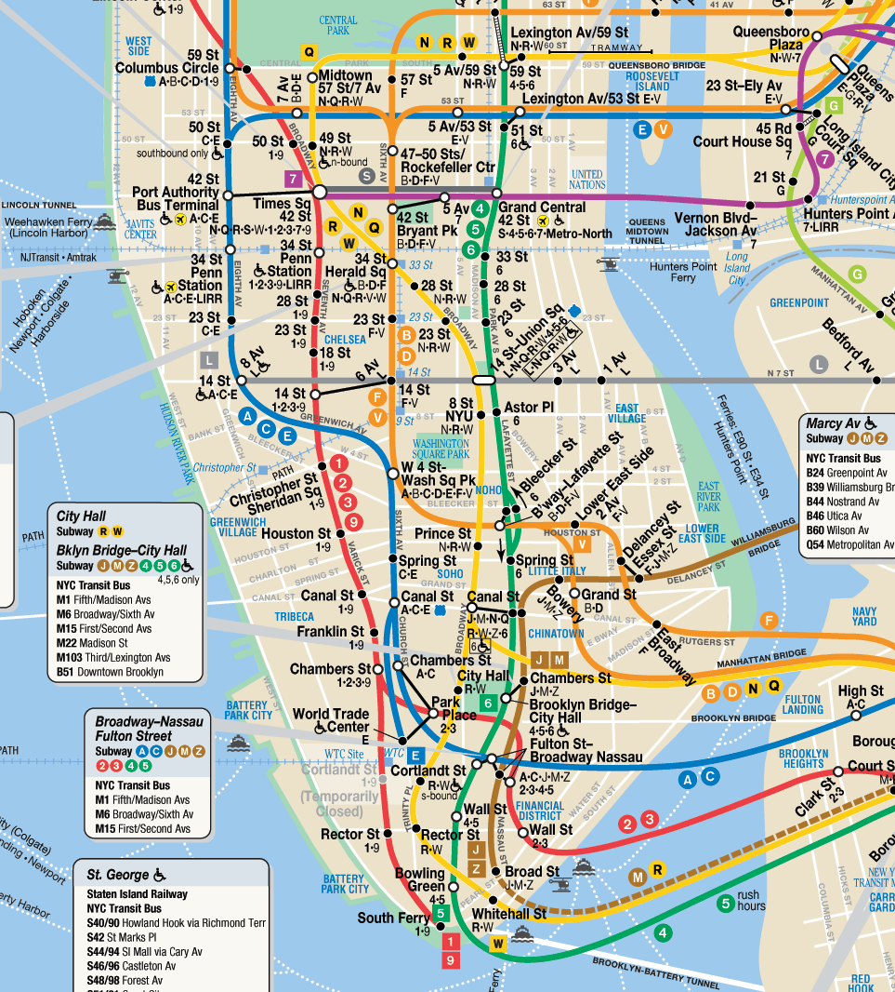

Slide 4
Reading a book: The eye moves left to right
Reading graphic novel: The eye moves left to right; when you reach the page margin, move down a row and back to the left margin

Slide 5
Key Graphic Novel Vocab
Splash page
Panel
Tier
Gutter
Balloons/Tails
Perspective
End splash
pages

Slide 6
SPLASH PAGE: first page: serves as an intro, a “launching pad for the narrative”; sets a “climate”
STEVE JOBS biography in graphic novel form:
Just like evolution of man image
“iVolution”- like Apple’s “i” products to connote individuality
Purpose: Hints at the transformation of Jobs as he worked for the Apple company after originally tinkering with electronics in his garage.
SPLASH PAGE

Slide 7
March
Book II
Splash
page
March
Book III
Splash
page
Ideas about meaning?

Slide 8
PANEL: a box or frame to set the boundaries or “containers” of the story segments
Its border matters: color, symmetry (or not), shape, width, overlaps
Example: Note that the bottom of the page doesn’t actually have a border as the news erupts from the radio, thereby signaling the pervasiveness and importance of the message as it reached Americans (especially Americans like John Lewis who had a vested interest in civic change).
PANEL

Slide 9
TIER: row of panels across a page
Example: As Lewis learned about the Brown v. Board of Education decision delivered by the Supreme Court (1954), he hoped for integration yet was disappointed in his parents’ attitudes that he should stay out of trouble.
TIER
Notes:
Top: image bleeds into next images: import of decision on Lewis; asymmetrical boxes hint at uncertainty

Slide 10
GUTTER: space between panels (size can indicate passage of time—is story slowing down, speeding up, passing in chunks, interrupted, etc.)
Example: John recalls the bus boycott and hearing about it on the news. So, to the right of the panel in the first tier, John reading the paper and listening to the radio features a COLLAPSE of a gutter to demonstrate how central/important the situation was in his life.
GUTTER

Slide 11
BALLOONS: dialogue boxes/ character speech bubbles
Shape matters to convey speaker’s feeling/mood or even the author’s tone
TAIL: pointer leading from balloon to speaker
BALLONS / TAILS

Slide 12
Note that the white text in the black space doesn’t have any balloon, indicating that it is commentary, like a voice-over in a movie.
The little boy’s questions have a curvy TAIL to hint at his uncertainty in asking questions. And his mother’s response, in an imperfect oval BALLOON, reveals her embarrassment at the questions.

Slide 13
PERSPECTIVE
PERSPECTIVE
Eye-level: image seen straight-on
Bird’s eye view (detachment—reader as observer looking down)
Ground level (image portrayed from a lower perspective)
Worm’s eye view (reader sees image from below the subject, inspiring fear or awe

Slide 14
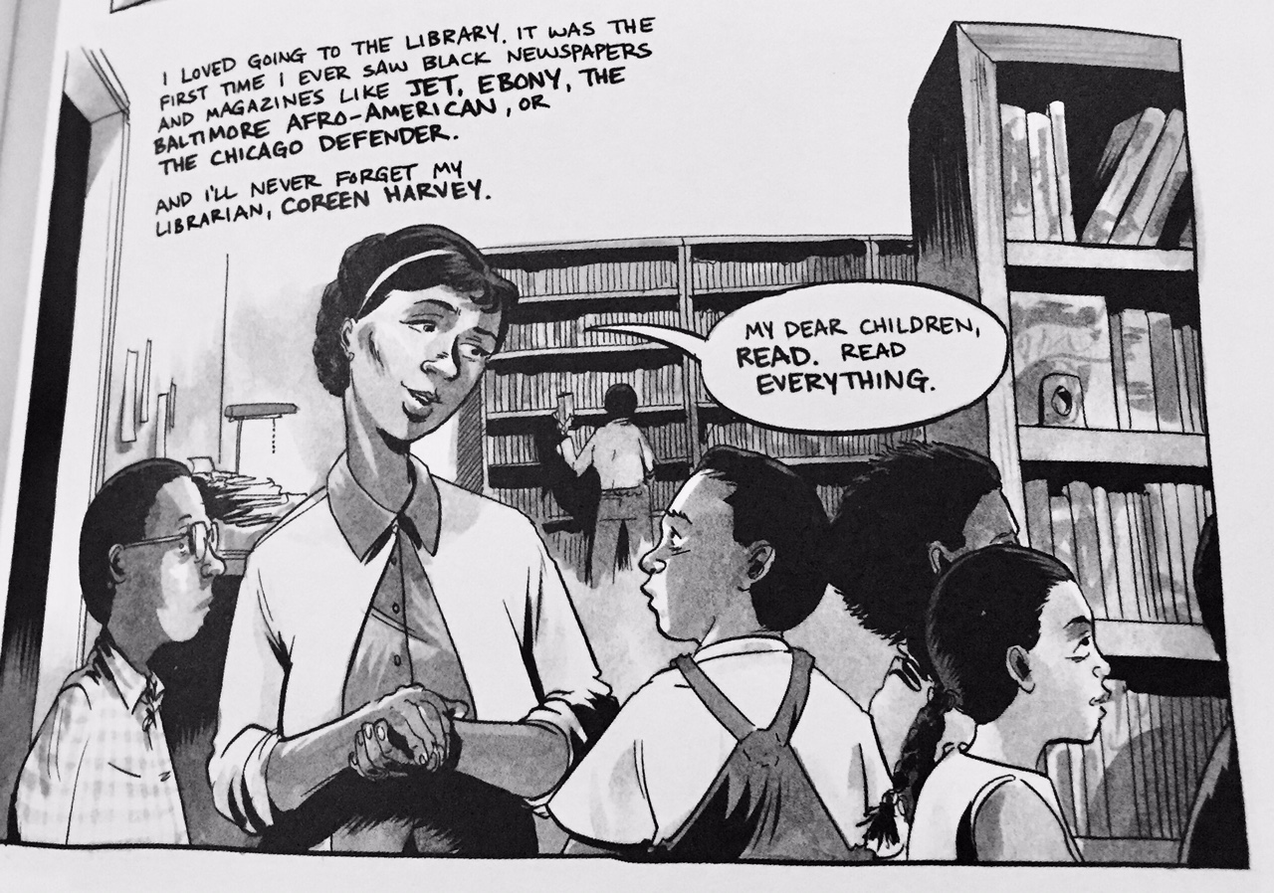
PERSPECTIVE: EYE-LEVEL

Slide 15
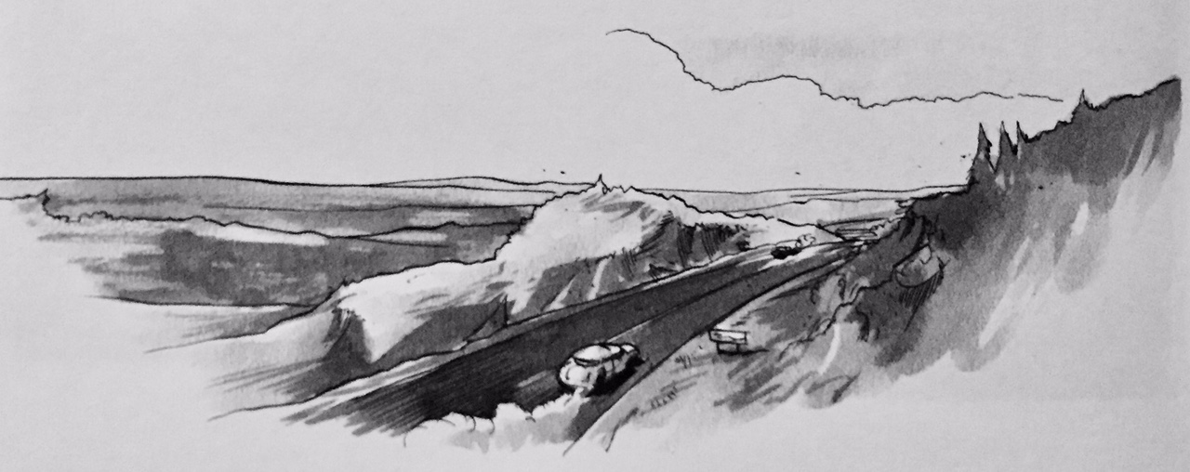
PERSPECTIVE: BIRD’S-EYE VIEW (also LONG SHOT b/c viewer sees a large, expansive picture rather than a little piece of it)

Slide 16
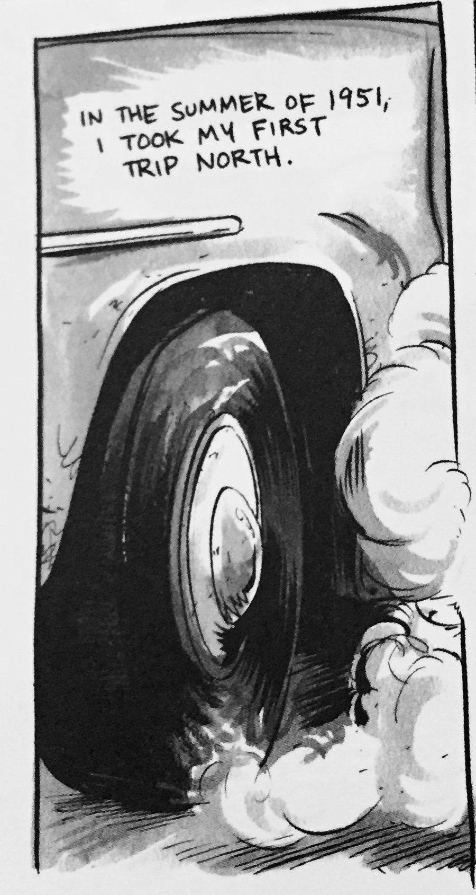
PERSPECTIVE: GROUND LEVEL

Slide 17
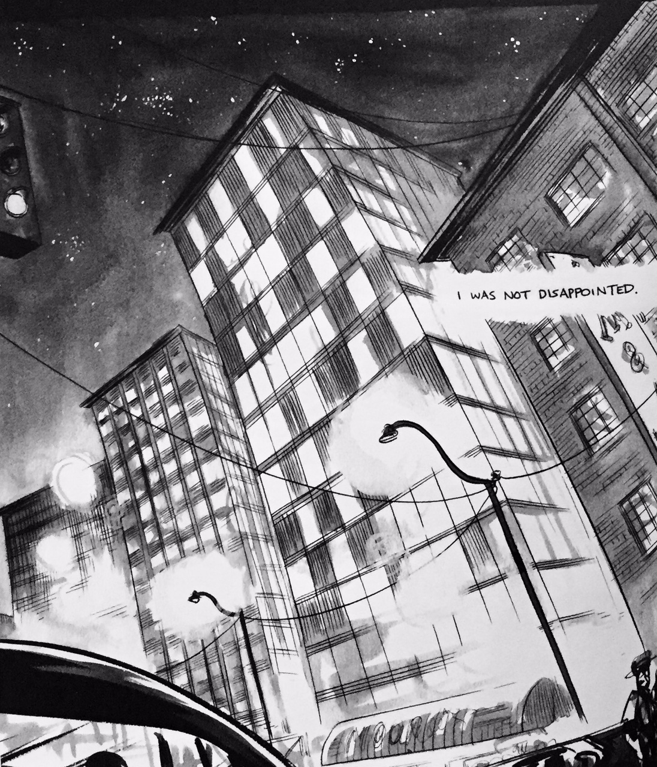
PERSPECTIVE: WORM’S-EYE VIEW

Slide 18
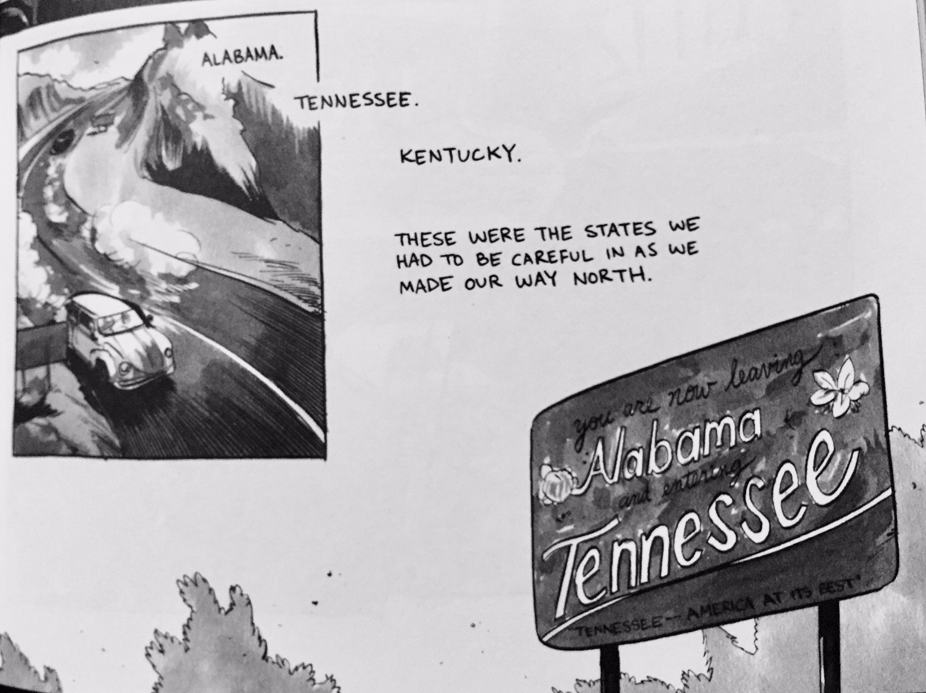
PERSPECTIVE: BIRD’S-EYE VIEW
PERSPECTIVE: WORM’S-EYE VIEW

Slide 19
OTHER CUES:
Character posture/body language
Subject representation: full size, part of the subject, close up
Onomatopoeia to portray sound effects related to mood, conflict, character reactions
Movement: conveyed through straight lines, arc lines, shading, blurred background
OTHER CUES

Slide 20
Character posture/body language
Figure representation: full size, medium figure, close up

Slide 21
Onomatopoeia to portray sound effects related to mood, conflict, character reactions

Slide 22
Movement: conveyed through straight lines, arc lines, shading, multiple images, blurred background

Slide 23
End Splash Pages
Ideas about meaning?

Slide 24
Panel transitions (probably too detailed, but just in case WE want to know; see McCloud 70-72)
Moment to moment
Action to action
Subject to subject
Scene to scene
Aspect to aspect
Non-sequitur

Slide 25
March
Book I
Splash
pages

